Slide 1
ECE 8893 Lab 2: Fixed-Point Stencil Computation
Ishaan Joshi

Slide 2
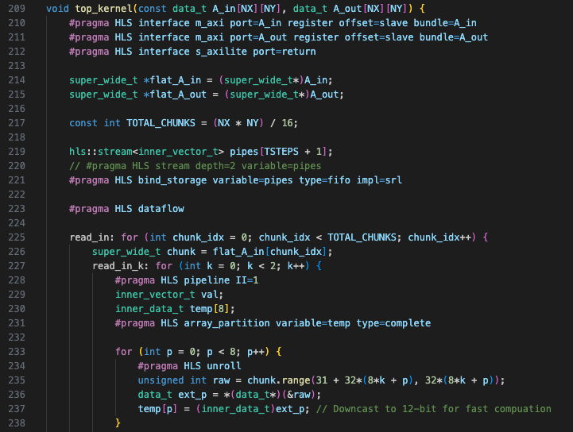
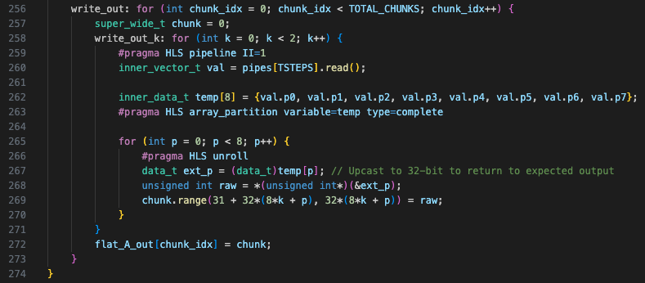
Techniques from Lab 1 (Speedup: 1x -> ~14x)
Selective unrolling
Pipelining
Partitioned BRAMs
Faster DRAM access (wide bandwidth)
Ping pong buffer
Limited speedup because computation patterns are different

Slide 3
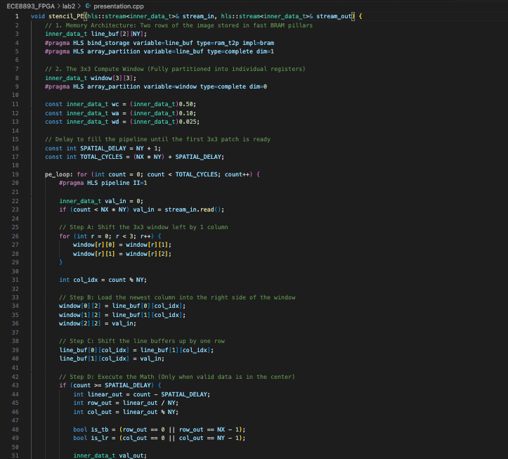
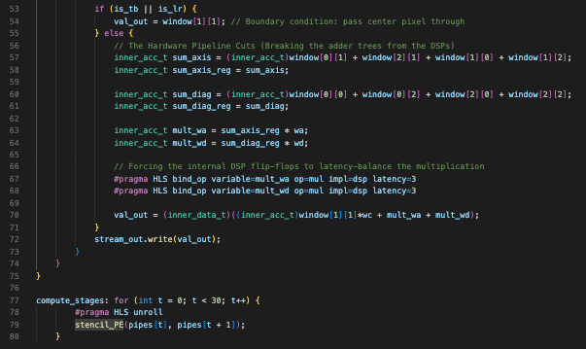
HLS Stream (Speedup: ~14x -> ~350x)
Define a Processing Element (PE) for each time step
Use a separate helper function within top.cpp
Function in C++ = Module in RTL. Unroll loop so that each Time Step PE is its own hardware
[Abstraction of Code, removed top_kernel function for readability]

Slide 4

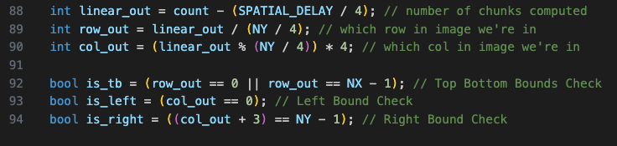
4x Parallelism: 4 Elements Per PE (Speedup: ~350x -> ~1400x)
Transfer 4 elements as input and output to every FIFO
Use struct to transfer data
Within PE, load all neighbors at the same time and “slide” across
Special checks to avoid computing over boundaries of matrix
Resource usage at this point is high
BRAM | DSP | FF | LUT
63 | 66 | 33 | 74
[Shift line buffer during operation]

Slide 5
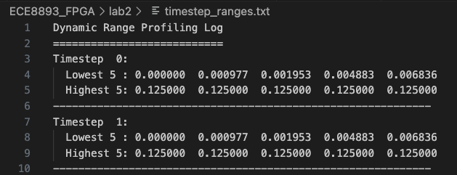
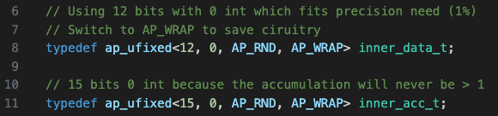
8x Parallelism (~1400x -> ~2000x)
Goal: bring down resource utilization through data type configuration and other fixes
Key observations from data analysis:
Data and accumulated values never go > 1
Definitely do not need <24, 8> and <40, 12> values passing through the whole architecture
AP_SAT flag was adding unnecessary circuitry for every element
Ran golden vs top comparison for precision checking until I got within 1% of allowed values
Cast to inner_data_t type values when loading data in, cast back to expected data_t values when writing out

Slide 6
8x Parallelism (~1400x -> ~2000x)
Data type configuration saved LUTs, FFs, and wires
However, DSP usage still a problem (240 / 360 with 4x parallelism)
FPGA was using 2 DSPs per element per PE
30 PEs * 4 elements/PE * 2 DSPs/element
Only wa and wc multiplications needed DSPs, everything else could use a shift register because it was a binary operation (* 2, / 4, etc.)
Use maximal DSPs and use longer multiplication chains for other elements

Slide 7

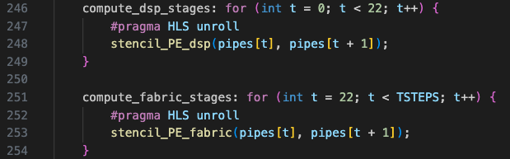
8x Parallelism (~1400x -> ~2000x)
To avoid high logical complexity within PE, define 2 types of Pes
First 22 PEs (22 PEs * 8 elements/PE * 2 DSPs/element = 352 < 360)
No.

Slide 8
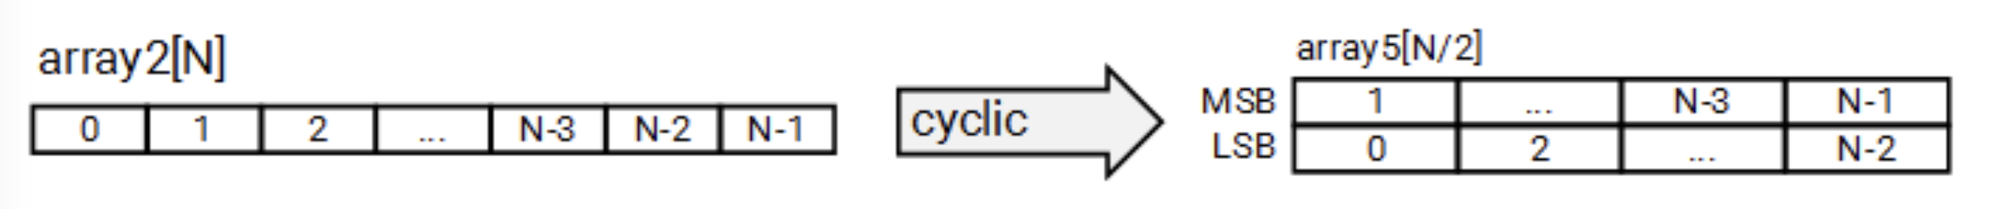
8x Parallelism (~1400x -> ~2000x)
Array Reshape pragma
Redefines how data is read in
Allows faster reads from partitioned BRAM
Partition dim=1 -> 2 rows at the same time
Reshape dim=2 factor=8 -> Larger data ports for faster data fetching per cycle
Clock Cycles = 9336, Clock Period = 7.5 ns
[From AMD Docs]

Slide 9
Timing Analysis (~2000x -> 2925x)
Iterative process of reducing clock period without increasing cycle count drastically
Register insertions to break up long timing paths
Many specific binding operations to reduce routing delay
Shift Register LUTs,
top_kernel_timing_paths_routed.rpt
top_kernel.cpp

Slide 10
Final Implementation
9338 Cycles
5.256 ns / cycle
= 2925x Speedup
LUT | FF | BRAM | DSP | Shift Register LUT | Configurable Logic Block
54.5% | 23.1% | 41.7% | 97.8% | 1528 | 7569

